Slide 1



Project : “ Connecting a wired and wireless LAN ”
Semester : 5th (A2)
Course : COM - 512
Computer Network Lab
Department :
‘ COMPUTER SCIENCE AND ENGINEERING ’
Parmeet Kour (2020a1r080) || Ishan Dhar (2020a1r076) || Manik Kaul (2020a1r079)
Incharge : MR. SUNIL KUMAR
Model Institute of
Engineering & Technology
Notes:
Presentation slide for courses, classes, lectures et al.

Slide 2
Contents :
What is LAN ?
Project : Connecting a wired and wireless LAN.
Introduction.
Network Devices Used.
Project View.
Demonstration.

Slide 3
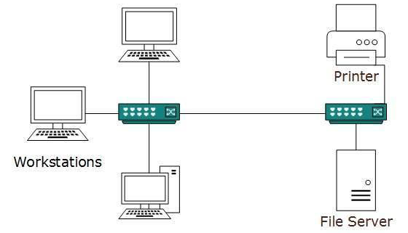
What is LAN ?
LAN stands for Local Area Network.
It is a collection of devices connected together in one physical location, such as building, office, or home.
Transmission speed of data is very high.
This network ownership is private.
Reduces costs, simplifies maintenance and upgrades .
Software updates and configuration are easier .
LAN connections include both wired and wireless connections.

Slide 4
Introduction :
What is Cisco Packet Tracer?
Packet Tracer is a cross-platform visual simulation tool designed by Cisco Systems .
Cisco Packet Tracer is Cisco's simulation software. It can be used to create complicated network typologies, as well as to test and simulate abstract networking concepts.
It acts as a playground for us to explore networking.
Packet Tracer allows users to drag and drop routers, switches, and other network devices to create simulated network topologies.

Slide 5
Wired and wireless networks :
A wired network is one where the devices in the network are connected using cables. Most wired networks are Ethernet networks.
Wireless networks use radio waves to connect devices. There are a range of wireless technologies, but the most common are Wi-Fi and Bluetooth. Many networks include both wired and wireless connections.

Slide 6

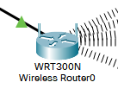
Network Devices :
Router :
The router is a physical or virtual internetworking device that is designed to receive, analyze, and forward data packets between computer networks. It uses the routing protocol to transfer the data across a network.
2. Wireless Router :
It is a device that enables wireless network packet forwarding and routing, and serves as an access point in a local area network. It works much like a wired router but replaces wires with wireless radio signals to communicate within and to external network environments.

Slide 7

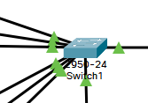

…
3. Access Point :
An access point is a device, such as a wireless router, that allows wireless devices to connect to a network.
4. Switch :
A switch is a small hardware device which is used to connect devices in a network and use packet switching to send, receive or forward data packets or data frames over the network. Network switches operate at layer 2 (Data link layer) in the OSI model.
4. Cables :
It is a transmission media that transmits the communication signals. Here, we are using Straight-through cable (type of twisted pair copper wire cable ).

Slide 8



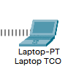

Other Devices :
PC :
Printer :
Laptop :
Tablet :
Smartphone :

Slide 9
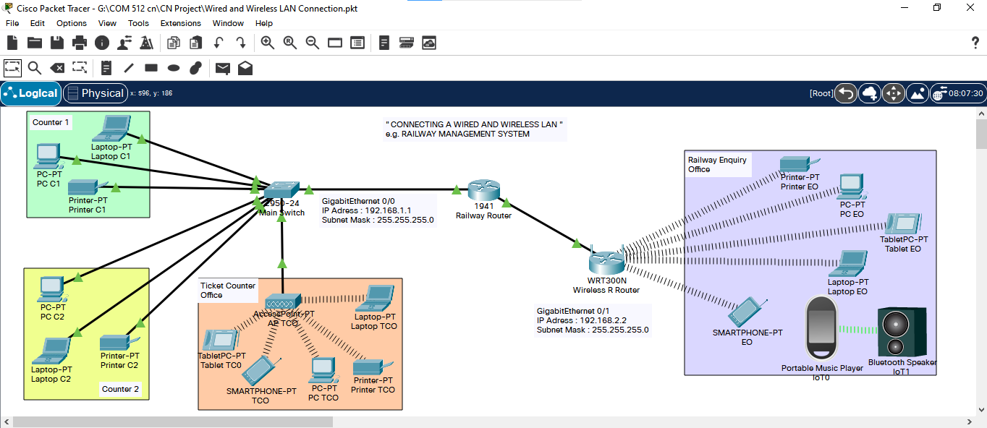
Project View :

Slide 10
Demonstration :

Slide 11
…
Thank You !

